Slide 1

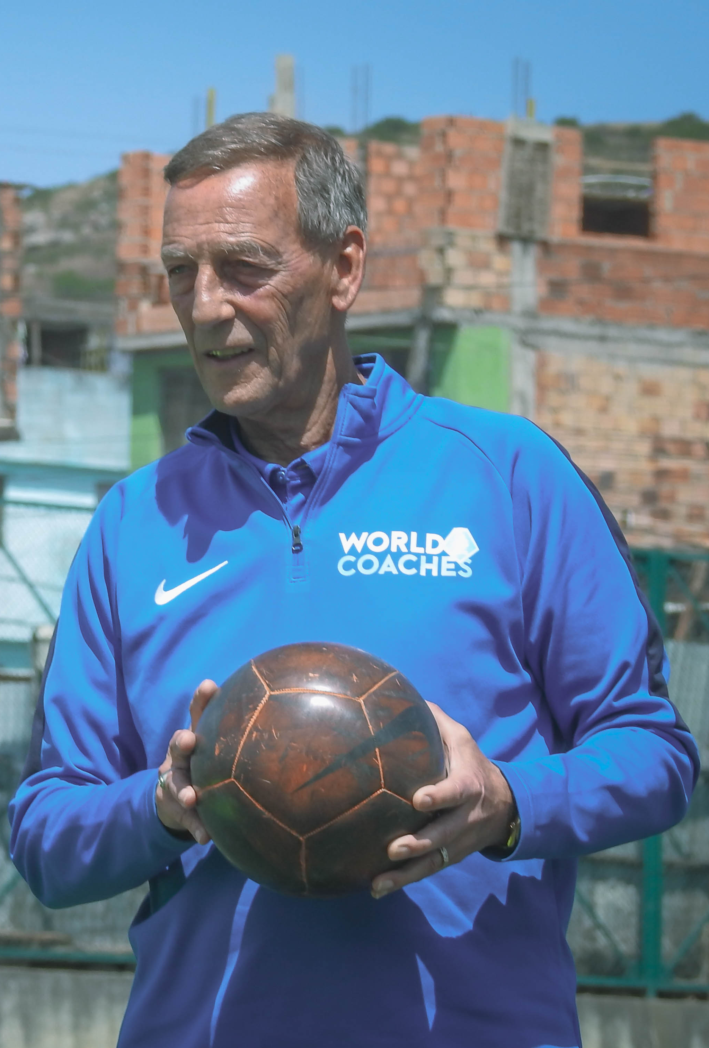

Slide 2
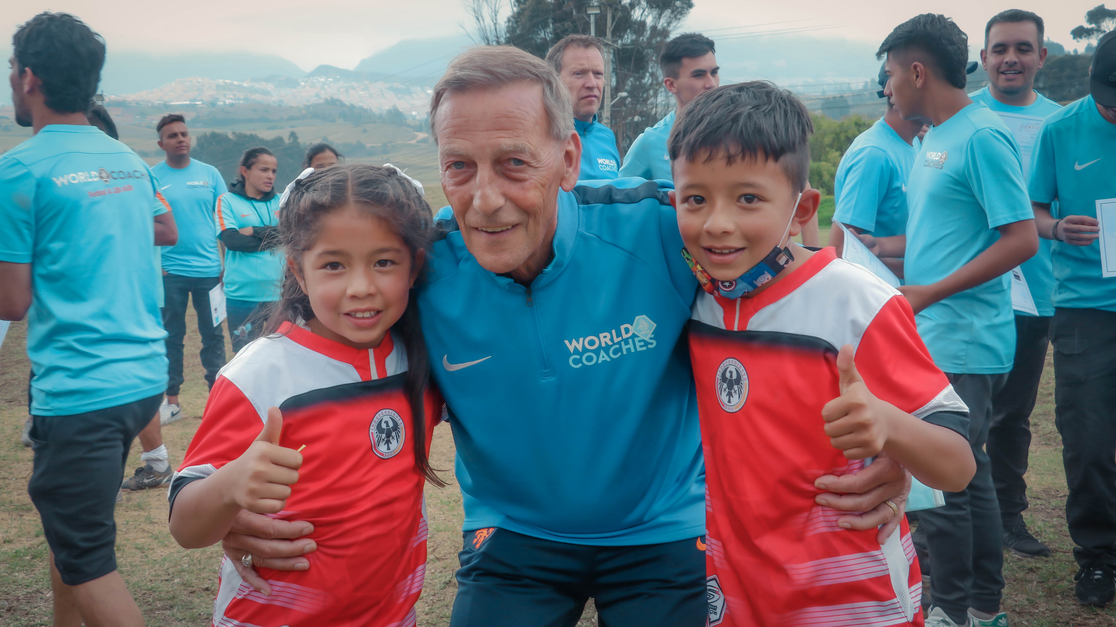
      The Johan Neeskens Legacy Grant was created by KNVB WorldCoaches to honour the lasting impact of Johan Neeskens. Not only as an iconic footballer, but above all as a person and a coach who believed deeply in the power of football to help others.
      On the pitch, Johan Neeskens was known for his commitment, teamwork and relentless drive, always putting the collective above himself. Off the pitch, and as an ambassador and instructor for the WorldCoaches programme, he embodied humility, generosity and passion. He was passionate about supporting young people to develop themselves and positively impact children, especially in communities where opportunities are limited. Johan believed that football can be a powerful tool to teach life skills, build confidence and create positive social change.
      The Johan Neeskens Legacy Grant comprises of EUR 4.900, referring to his 49 caps for the Dutch national team, and is awarded annually to a (group of) coach(es) for organising an event that uses football to benefit children and/or youth facing social challenges. Through this grant, KNVB WorldCoaches aims to continue Johan Neeskens’ legacy by investing in coaches who share his values and who are committed to developing young people, both as footballers and as individuals.

Slide 3
      ELIGIBILITY CRITERIA
      You can apply for the Johan Neeskens Legacy Grant if you meet the following conditions:
      You are a WorldCoach who has completed at least introductory level
      You will implement the proposed activity individually or with a group (max. 5 participants)
      Your proposal uses football as a tool for social impact
      Your written proposal is submitted in English (use of translation tools is allowed) and must include a budget of how the EUR 4.900 will be spent
      You are able to receive the funds through an international bank transfer (please check if this is possible before applying) or through a WorldCoaches-partner if WorldCoaches is still active in your country
      Your event will be implemented in 2026
      PROJECT CRITERIA
      Your proposal should include at least the following information:
      Name(s) of applicant(s)
      Country and city of implementation
      Contact details (email and phone number)
      Title of the event
      Date of event(s)
      Goal(s) and description of the event (between 400-800 words)
      Location of the event
      Description of the target group (age, gender etc.)
      Estimated number of participants (boys/girls)
      Social issue(s) that will be addressed (e.g. bullying, gender equality, social cohesion)
      Why is this initiative relevant for the community?
      Which local stakeholders will be included? (e.g. municipality, school, local business

Slide 4
      REPORTING REQUIREMENTS
      After implementation of the event, you must send us:
      A short report about the event including the achievements
      Number of children reached through the activities, their gender and age
      Pictures (and videos) of the event
      ALLOCATION PROCEDURE
      All applications will be scored independently by two staff members from the WorldCoaches dpt. to make a shortlist of 3 – 5 proposals
      A jury will assess the shortlist and will score each application individually
      Scores of the jury members are added up and the highest total score wins
      In case of a tie, the jury will meet and determine a winner
      If you are interested, please submit your proposal no later than May 31st, 2026, by sending an email with all the required information to WorldCoaches@KNVB.nl.
      You will be informed with the results no later than June 30th, 2026, after the deadline.

